Slide 1
Data Completion and Quality
Variable | # of Missing Data Points | Percentage of Data Missing (%)
I Identify As | 0 | 0
Age | 1 | 0.21
Person with disability | 0 | 0
Inuit | 0 | 0
First Nations | 0 | 0
Métis | 0 | 0
Deaf | 0 | 0
Deafblind | 0 | 0
Francophone | 0 | 0
Goal Path | 0 | 0
Education | 9 | 1.89
Language Spoken at home | 9 | 1.89
Language Spoken at last workplace | 9 | 1.89
Service Provision Language | 9 | 1.89
Source Of Income | 9 | 1.89
Education Country | 9 | 1.89
Time out of School | 9 | 1.89
Time out of Training | 9 | 1.89
History of Interrupted Education | 9 | 1.89
Labour Force Attachment | 9 | 1.89
Employment Experience | 9 | 1.89
Time out of Work | 9 | 1.89
Outcome @ 3 months | 311 | 65.20
Methods:
Data was sorted on Excel to identify zero values within variables
Variables with 9 missing data points are all from the same 9 individuals
Large issue in data collection

Slide 2
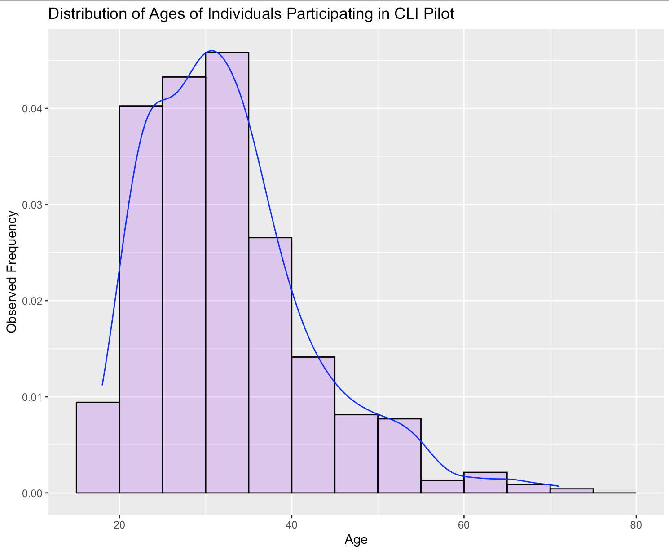
Analysis of Age
Methods: Histogram was made on RStudio using ggplot2 library. Functions used include ggplot, geom_histogram, and geom_density
Descriptive Statistics
Mean | 32.73
Median | 31.00
Maximum | 71.00
Minimum | 18.00
1st Quartile | 26.00
3rd Quartile | 37.00
Interquartile Range | 11.00
Variance | 91.79
Standard Deviation | 9.58

Slide 3
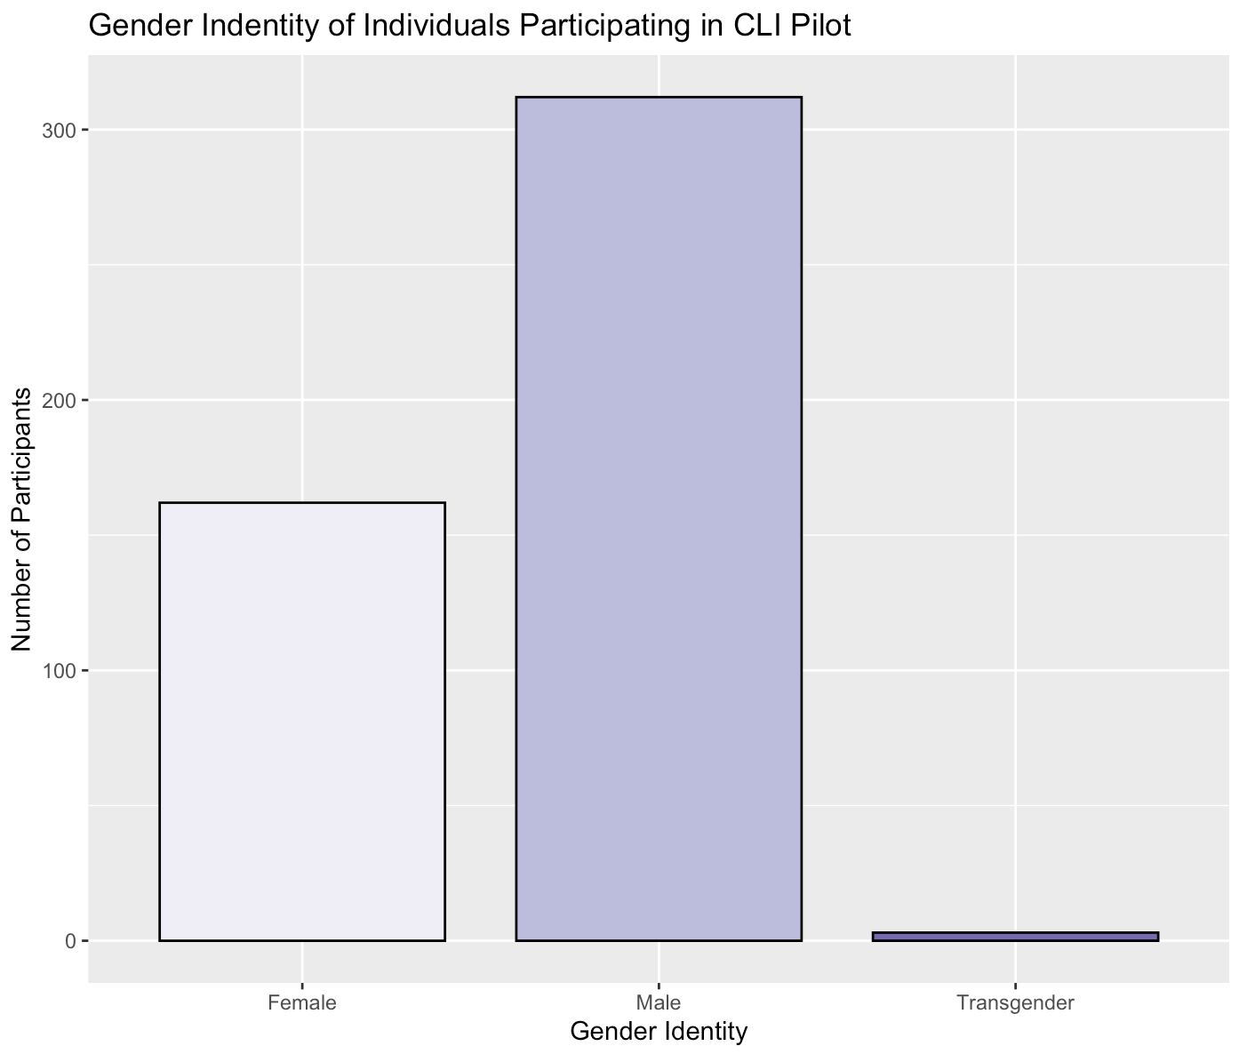
Analysis of Gender
Methods: Bar plots were made on RStudio using ggplot2 library. Functions used include ggplot and geom_bar.
Gender Identity | Number of Participants | Percentage of Participants (%)
Female | 162 | 33.96
Male | 312 | 65.41
Transgender | 3 | 0.63

Slide 4
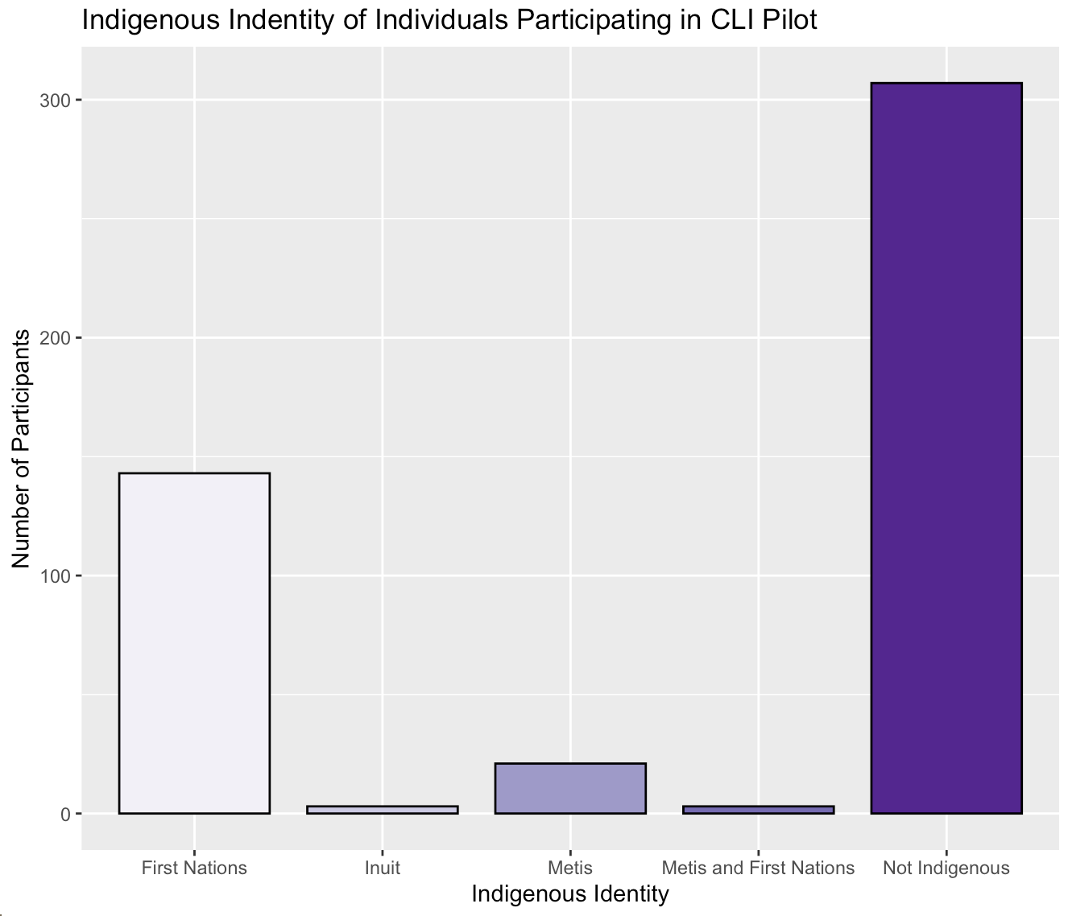
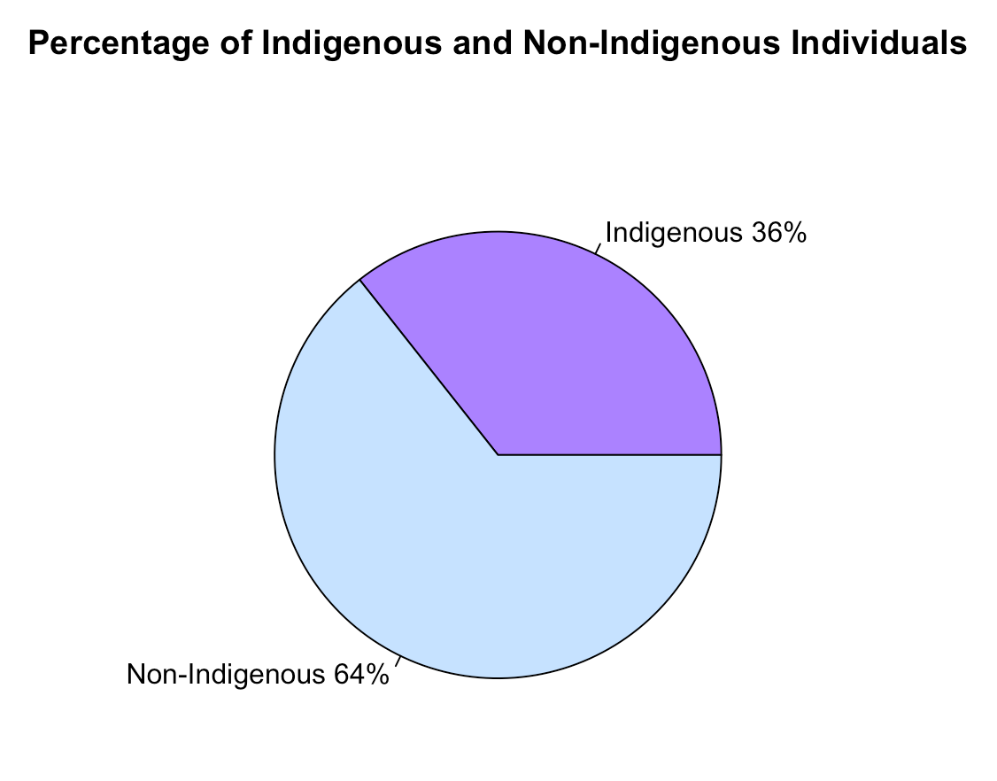
Analysis of Indigenous Identity
Methods: Pie chart made using pie function

Slide 5
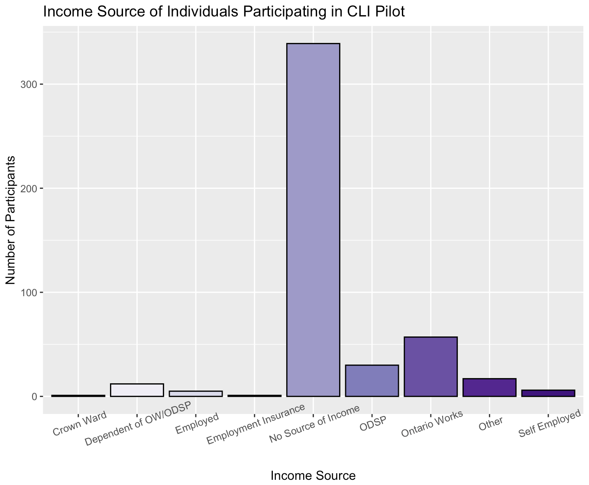
Analysis of Income
Methods: Bar plots were made on RStudio using ggplot2 library. Functions used include ggplot and geom_bar.
72.44% Participants have no source of income

Slide 6
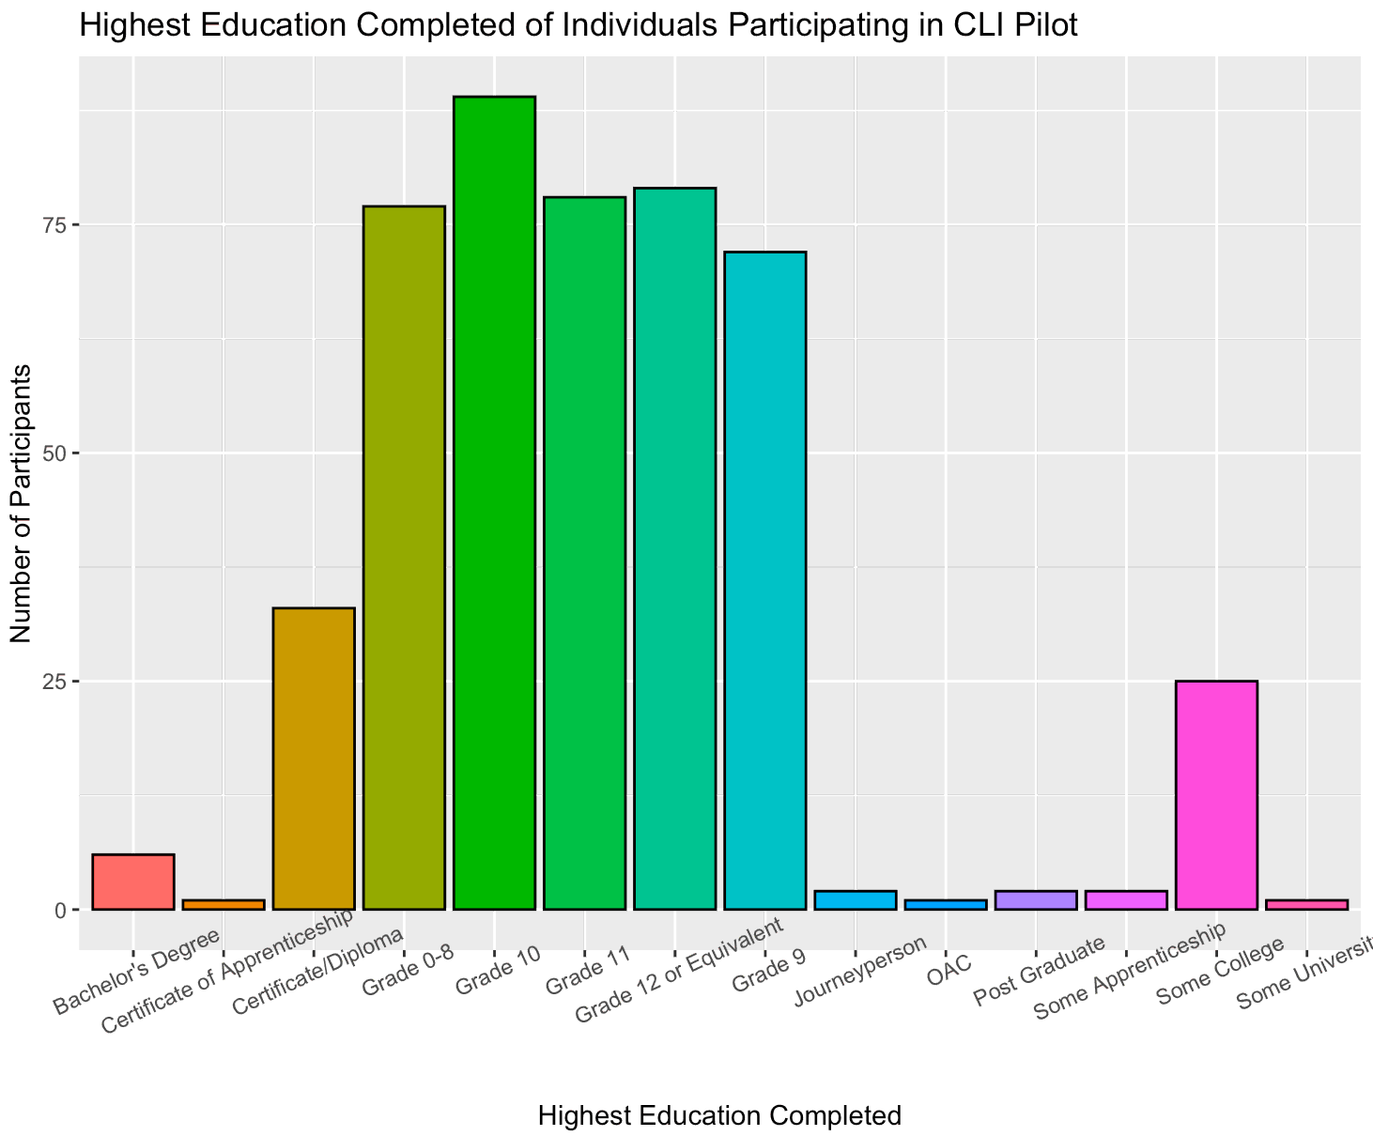
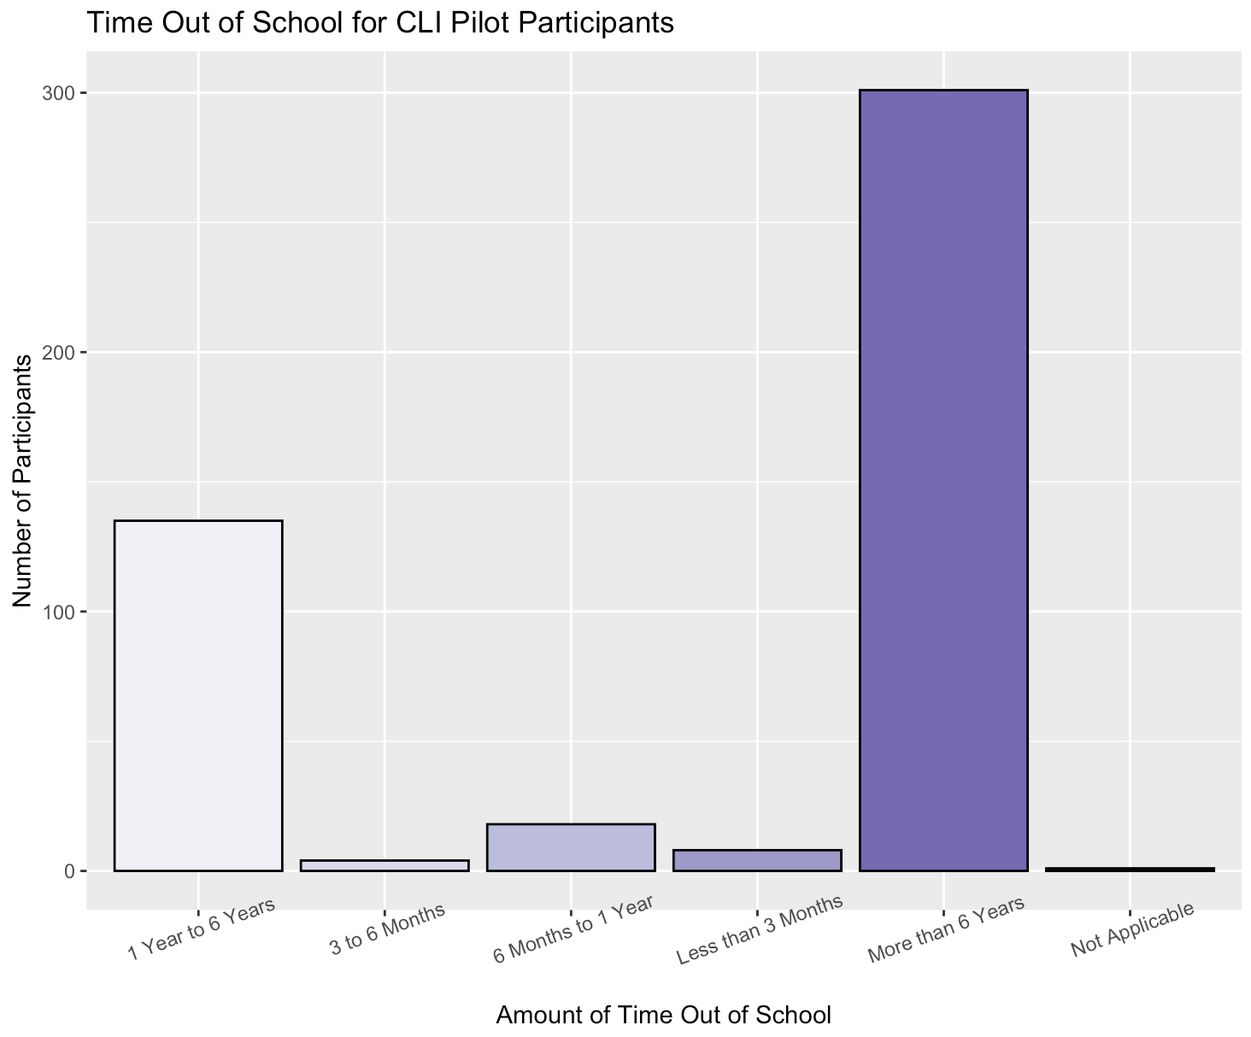
Analysis of Education Level
77.73 percent of participants have a history of interrupted education
97.22 percent of participants completed their education in Canada
67.45 percent of participants have not completed high school and 16.45 percent have not started any high school. This may indicate that the program is reaching the intended population.

Slide 7
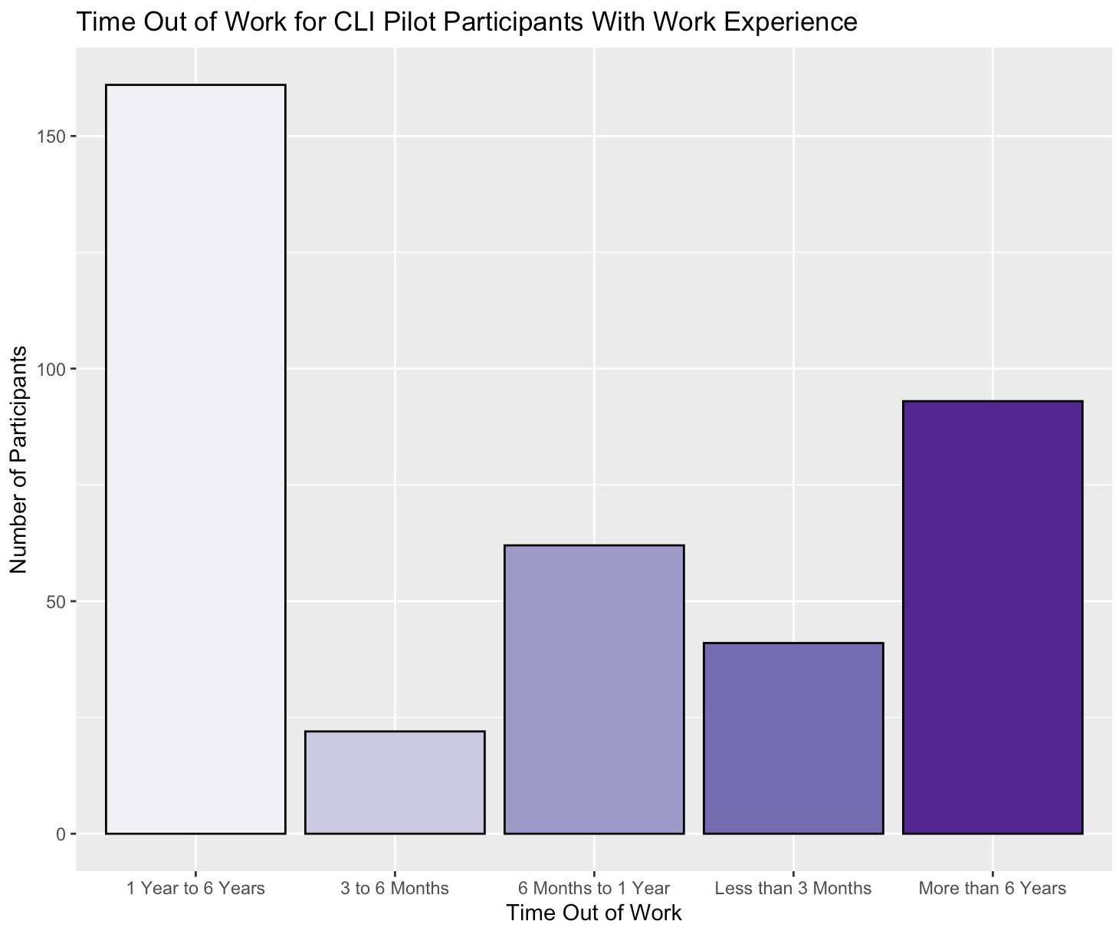
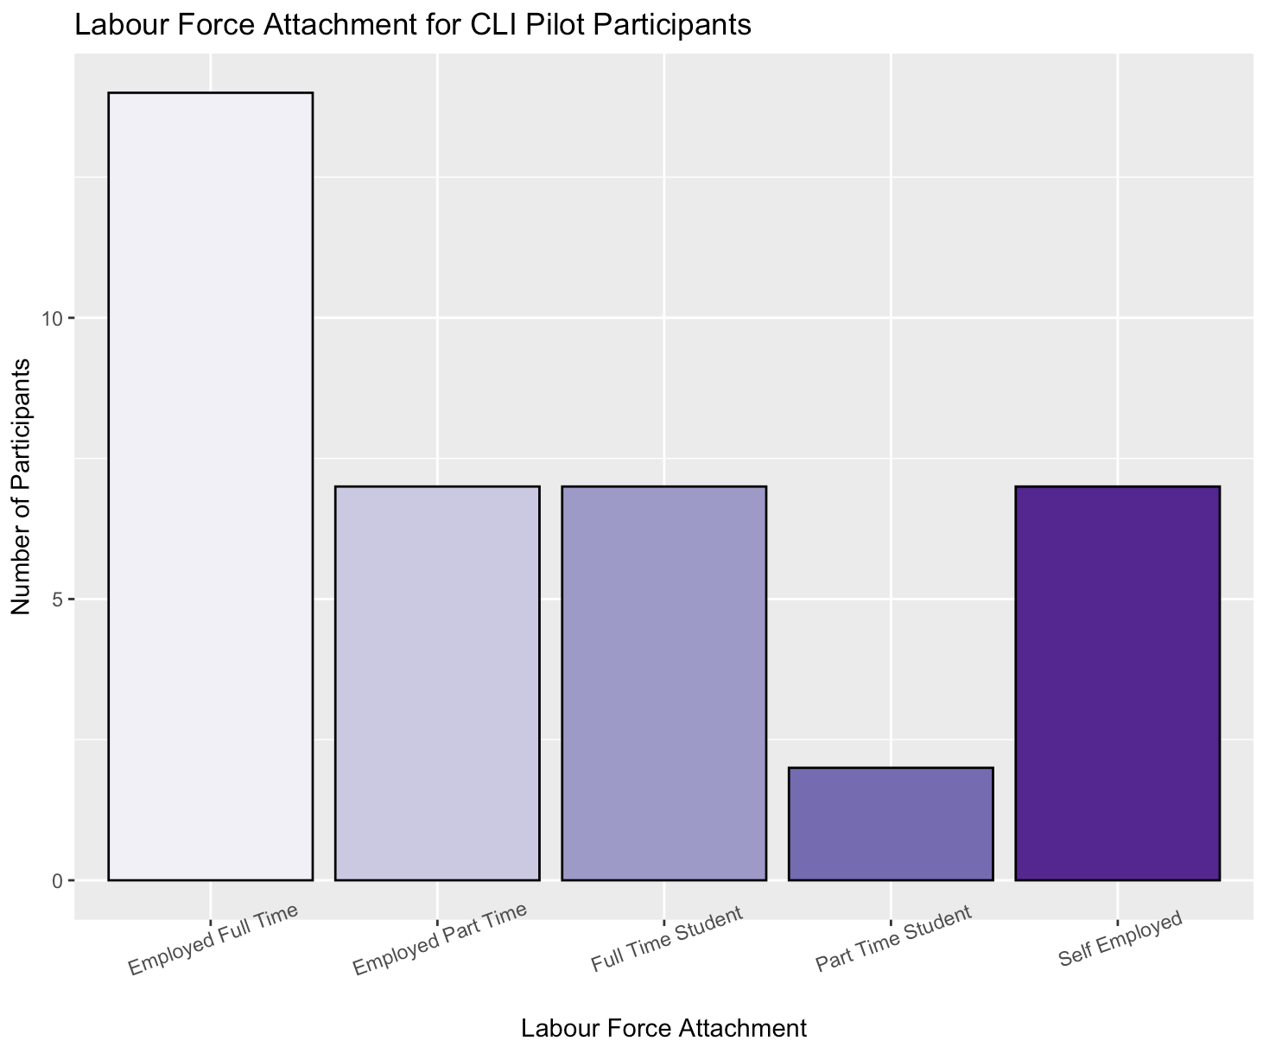
Employment History
83.94% of participants have previous work experience
Labour Force Attachment for 92.08% Participants is Unemployed

Slide 8
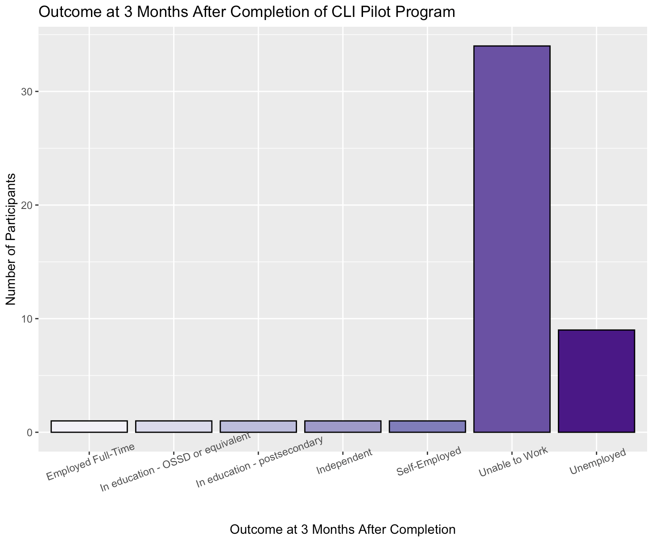
Outcomes of Participants
Outcome | Number of Participants | Percentage of Participants
Employed Full-Time | 1 | 0.21
In education - OSSD or equivalent | 1 | 0.21
In education - postsecondary | 1 | 0.21
Independent | 1 | 0.21
Self-Employed | 1 | 0.21
Unable to work | 34 | 7.13
Unemployed | 9 | 1.89
Unknown | 118 | 24.74
Missing Values | 311 | 65.20
Outcome at 3 Months after program completion is unknown or missing for 89.94%

